Slide 1

Coffee Aftertaste Quality
Analysis
- Shusant Sapkota

Slide 2

Agenda
Motivation
Plan
Dataset
Features Analysis
Findings of Analysis
Applying ML
Outcome
Limitations
Future Enhancement
Conclusion

Slide 3
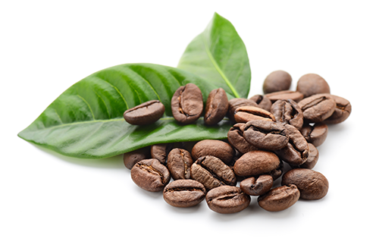
1. Motivation
Global Coffee Consumption
Countries Producing Most Coffee
Most Popular Drink
2 Billion Cups in a Day
167.59 Million Bags in 2019
Brazil
Vietnam
Columbia
Countries Consuming Most Coffee
Finland
Norway
Iceland
Health Benefits
Provides Energy.
Provides Essential Nutrients.
Reduces chances of severe diseases.
Largest Coffee Selling Companies
Starbucks
Tim Hortons
Panera Bread

Slide 4


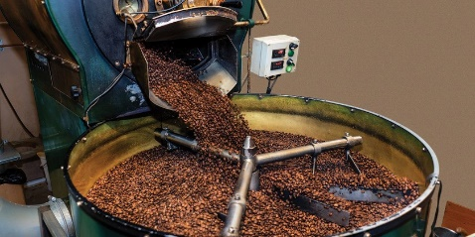

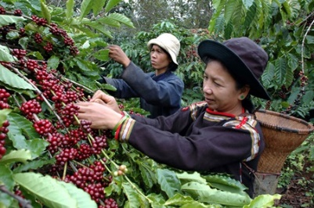
1. Motivation
Common Focus Point
People
People always tend to drink good quality and healthy coffee. Though each Individual have their own preferences.
Companies
Coffee Quality
Coffee Quality
In coffee shops, people came to have their favorite coffee. Since, people prefer quality coffee. Company will try to serve based on people’s preferences.
Processing Mills
They serve coffee shops all over the world. Quality processed coffee are preferred by most of the big shops.
Farmers
When the quality of grown coffee is good, they’ll get market easily.

Slide 5
1. Motivation
What Impacts Coffee Quality ?
Sweetness
Aroma
It is the intensity of the sugary qualities of the coffee when swooshed around in the mouth.
It is the flavorful components from coffee through air. It depends upon processing, moisture, and roasting. It’s responsible for flavor attributes not directly perceived by the tongue. Stale coffee smells musty and cardboard-like
Beans Shape
If there are defects in the shape of coffee, the coffee made from it under quality. This may be due to roasting, harvesting, by birth.
Freshness
It is to have original unimpaired qualities. Aroma, moisture, sweetness depends on it.
Moisture
Color
It indicates the maturity of the beans. ICO recommends having moisture of 8 to 12.5% after drying the beans. Good levels of moisture enhances aroma and acidities of a coffee.
The lighter roasts are better. Most dark roast beans are only roasted to cover up any defects. But, it depends upon personal preference.

Slide 6
1. Motivation
Overall Impact
Aroma
Sweetness
Beans Shape
Aftertaste
Moisture
Color
Freshness

Slide 7
2. Plan
01
Data
Find the appropriate data about coffee quality features that impact Aftertaste.
02
Analysis
Discover most Important Features affecting Aftertaste.
03
Model
Develop ML Model to measure impact of Features in Aftertaste. It can predict Aftertaste.

Slide 8
3. Dataset
Target : After taste
No of features: 43 features
Quality Features
Bean Features
Farm Features
Aroma, Flavor, Acidity, Body, Balance, Uniformity, Clean Cup, Sweetness, Bean Defects, Moisture.
Processing Methods, Color, Species, Defects.
Owner, Country of Origin, Farm Name, Lot Number, Mill, Company,
Altitude, Region, etc.

Slide 9
4. Analysis
Dealing With Null Values
3
2
1
Find Null values distribution in dataset
The 17 features in the dataset have null values
Identify no. of null values in each features
Lot Number, Producer have highest no. of null values
Not considered for further processes
Features with many null values are not considered

Slide 10
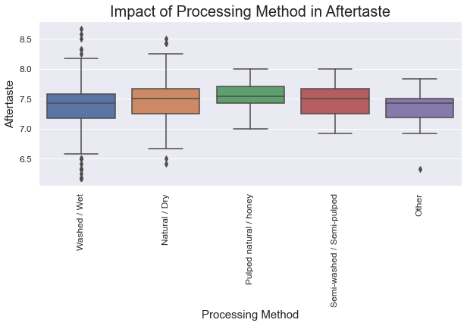
Impact of Processing Method in Aftertaste
4. Analysis
Four major processing methods
Few follow other processing methods
Median value for all colors are in same range
Similar Inter-quartile range
No impact in Aftertaste

Slide 11
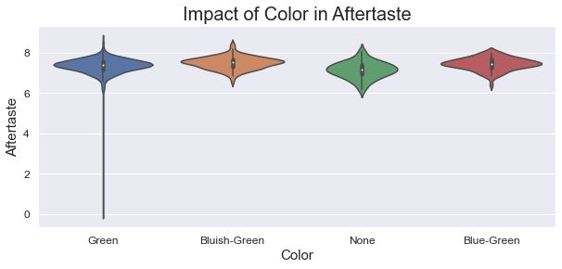
Impact of Color in Aftertaste
4. Analysis
Three colors of coffee
Some coffee color are not mentioned
Median value for all colors are in same range
Similar Inter-quartile range
No impact in Aftertaste

Slide 12
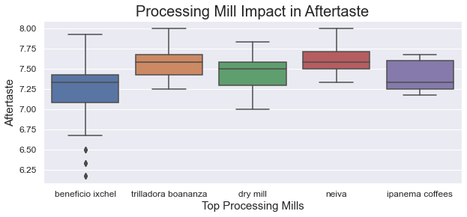
4. Analysis
Top Processing Mills and their Aftertaste
Top five mills are considered
All mills have median aftertaste value around close range
No direct impact in Aftertaste

Slide 13
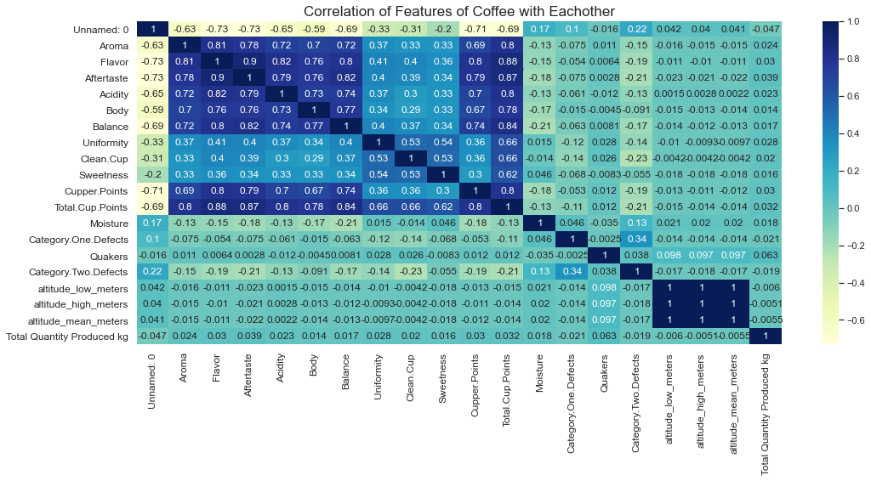
4. Analysis
Numerical Columns affecting Aftertaste
Aroma
Flavor
Aftertaste
Acidity
Body
Balance
Uniformity
Clean Cup
Sweetness
Cupper Points
Moisture
Category Two Defects

Slide 14
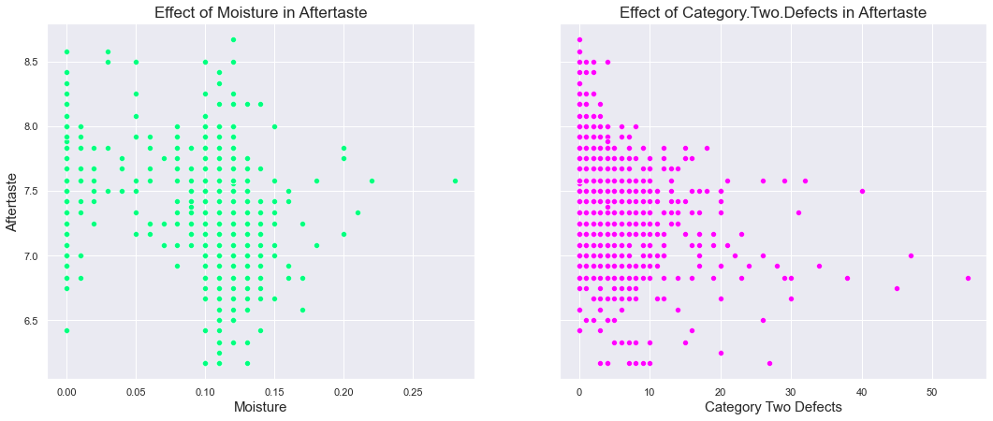
4. Analysis
Impact of Moisture in Aftertaste
Randomly Scattered
No any patterns
Not Considered for Further Processes

Slide 15
4. Analysis
Impact of Bean Defects in Aftertaste
Negative Relation
Only few points have patterns. But large data though they have low value of defects, they have low value of aftertaste.
Not Considered for Further Processes

Slide 16
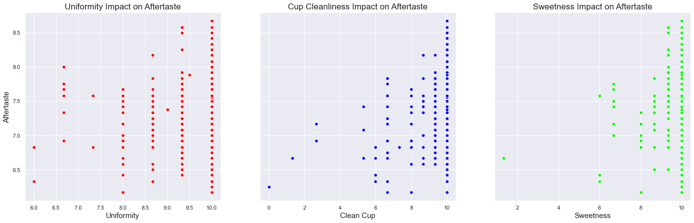
4. Analysis
Impact of Uniformity in Aftertaste
Most of Uniformity have value 10
Randomly Scattered
No any patterns
Not Considered for Further Processes

Slide 17
4. Analysis
Impact of Clean Cup in Aftertaste
Most of Uniformity have value 10
Randomly Scattered
No any patterns
Not Considered for Further Processes

Slide 18
4. Analysis
Impact of Sweetness in Aftertaste
Most of Uniformity have value 10
Randomly Scattered
No any patterns
Not Considered for Further Processes

Slide 19
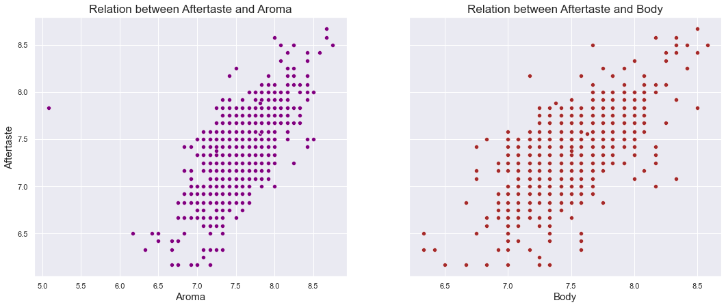
4. Analysis
Impact of Aroma in Aftertaste
Datapoints are along a straight line
Positive Relation, as aroma in coffee increases its aftertaste also increases
Considered for Further Processes

Slide 20
4. Analysis
Impact of Body in Aftertaste
Datapoints are along a straight line
Some Points are sparse from central line
Positive Relation, as aroma in coffee increases its aftertaste also increases
Considered for Further Processes

Slide 21
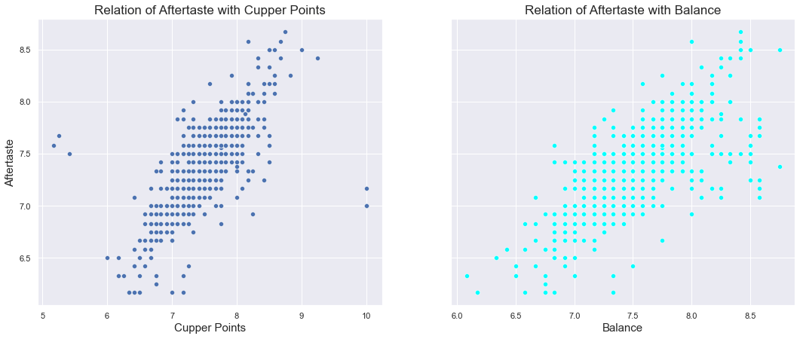
4. Analysis
Impact of Cupper Points in Aftertaste
Datapoints are along a straight line
Positive Relation, as aroma in coffee increases its aftertaste also increases
Considered for Further Processes

Slide 22
4. Analysis
Impact of Balance in Aftertaste
Datapoints are along a straight line
Positive Relation, as aroma in coffee increases its aftertaste also increases
Considered for Further Processes

Slide 23
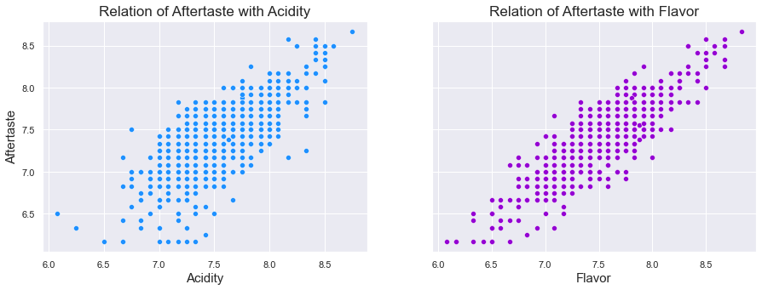
4. Analysis
Impact of Acidity in Aftertaste
Datapoints are along a straight line
Positive Relation, as aroma in coffee increases its aftertaste also increases
Considered for Further Processes

Slide 24
4. Analysis
Impact of Flavor in Aftertaste
Datapoints are dense and along a straight line.
Positive Relation, as aroma in coffee increases its aftertaste also increases
Considered for Further Processes

Slide 25
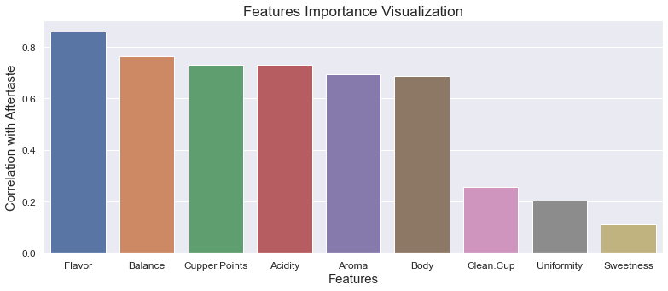
5. Findings of Analysis
Most Important Features

Slide 26
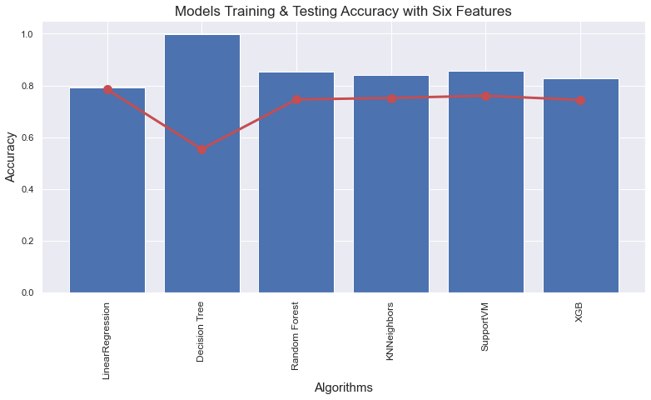
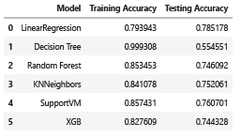
6. Applying Machine Learning
Using Six Features
Aroma
Acidity
Cupper Points
Flavor
Balance
Body

Slide 27
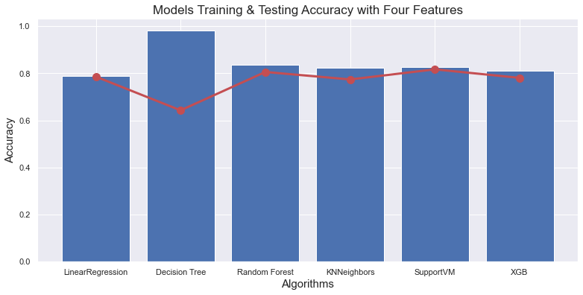
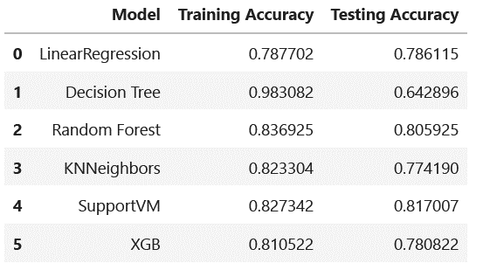
5. Applying Machine Learning
Using Four Features
Flavor
Acidity
Cupper Points
Balance

Slide 28
7. Outcome
Important Features for Aftertaste
Actual Dependencies
Prediction
The Aftertaste is around 81% dependent upon these four features
ML model can be used to predict Aftertaste from four features with 80% accuracy.
Flavor,
Acidity
Balance
Cupper Points.

Slide 29
8. Limitations
From the discovered features, model is 81% efficient. There is still descent room to improve the efficiency.
Unknown about model performance in Real World

Slide 30
9. Future Enhancement
Discover more useful features to improve the efficiency of model
Use neural network for improving the efficiency
Deploy in web/app for easy access and use
Testing and Feasible Study in Real World

Slide 31
Conclusion

Slide 32
Any Queries

Slide 33
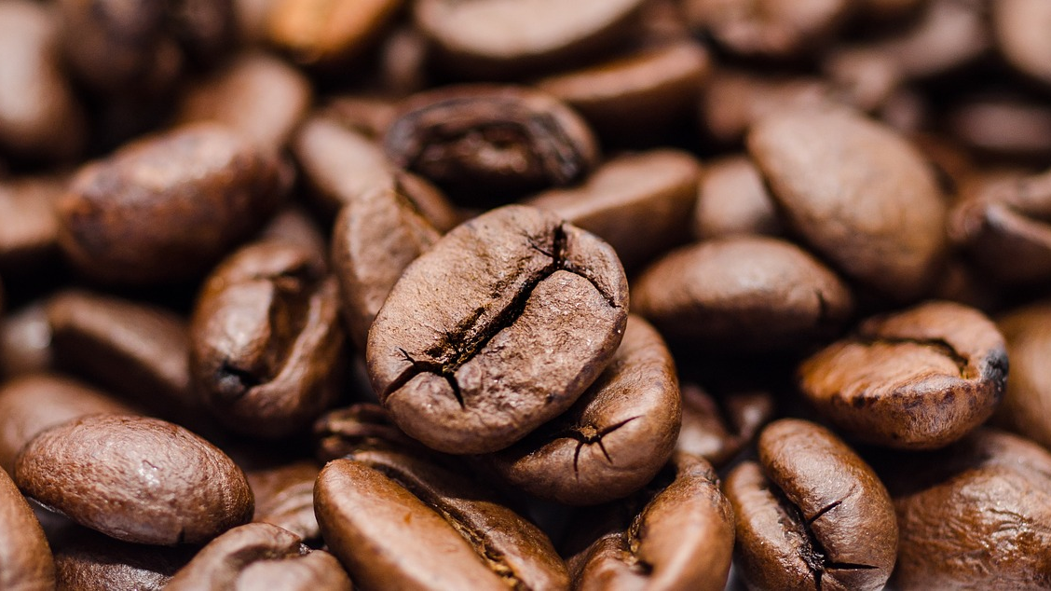
Thank You

